Slide 1

Working title: CFD and ROM of Flow over a Golf Court
Bachelor project, 2026
Meeting 2, date: 17-03-2026
GROUP 3
Eske Freiesleben
Jacob Manniche
J. Alfred Pedersen
Student ID
S234229
S234258
S230869

Slide 2
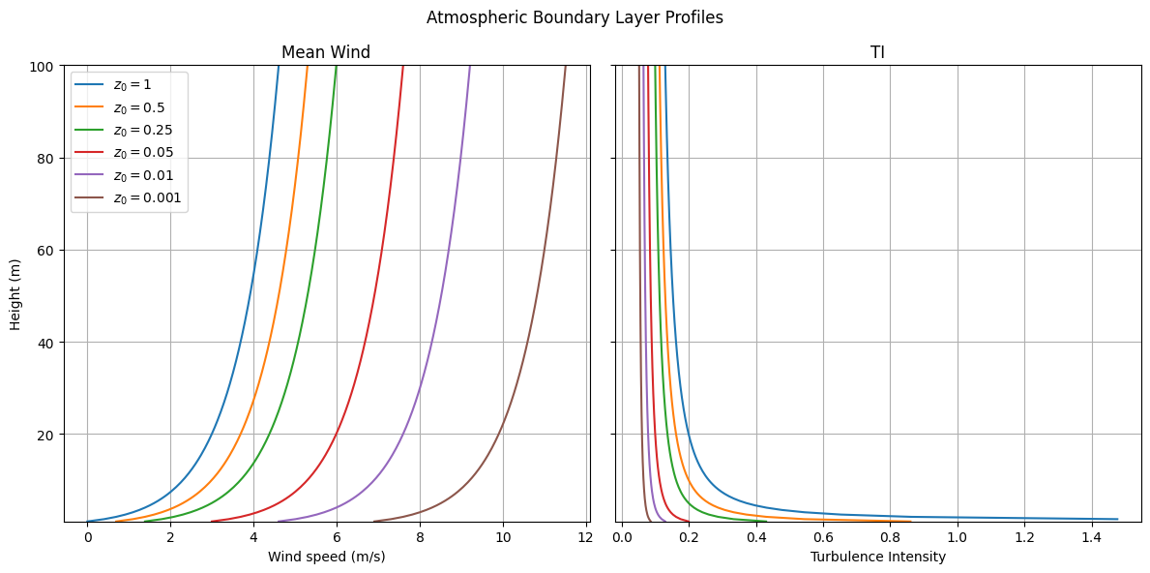
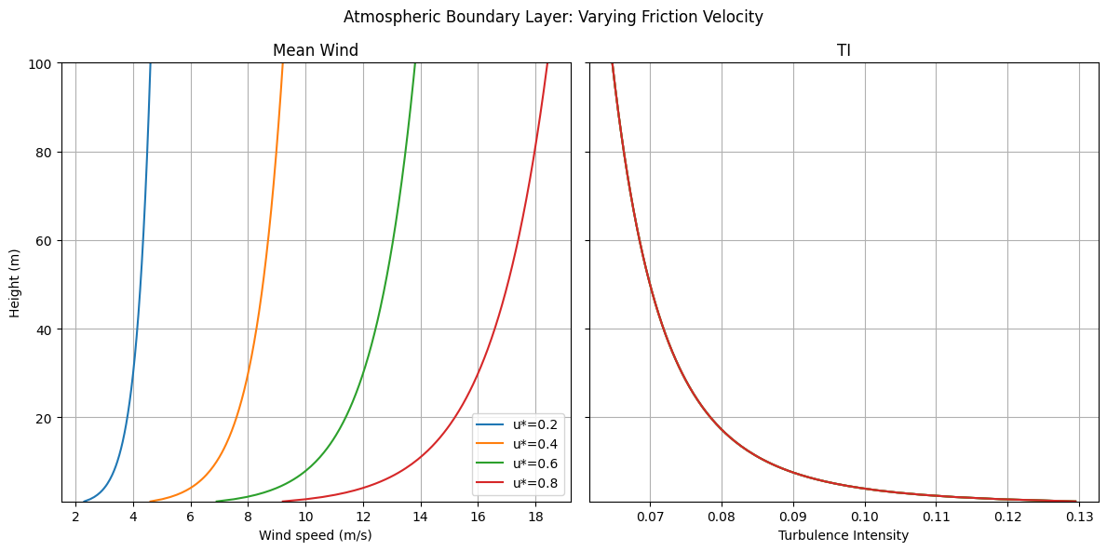
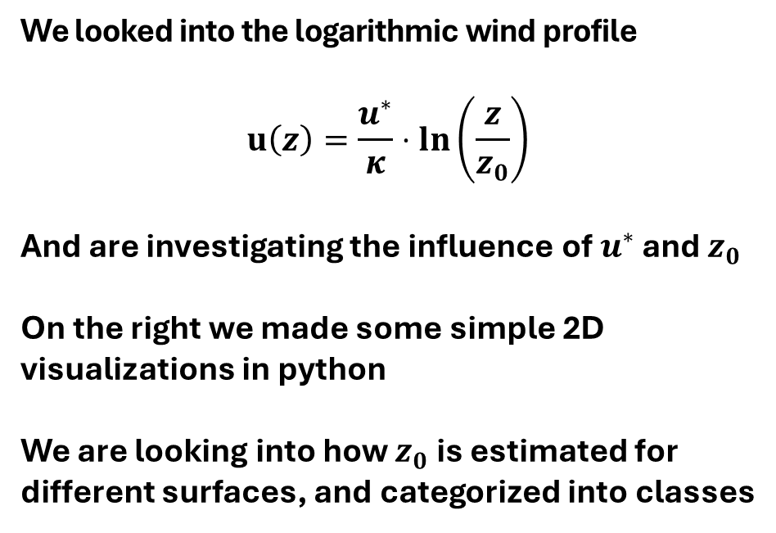
Status update: Theory 1/5
We looked into the logarithmic wind profile
$$u\left(z\right)=\frac{u^{∗}}{κ}⋅ln\left(\frac{z}{z_{0}}\right)$$
And are investigating the influence of $u^{∗}$ and $z_{0}$
On the right we made some simple 2D visualizations in python
We are looking into how $z_{0}$ is estimated for different surfaces, and categorized into classes
Bachelor project:
CFD and ROM of Flow over a Golf Court

Slide 3
Status update: Structure 2/5
Theory
Wind profile over flat terrain 2D
Logarithmic wind profile
Surface roughness
Friction velocity u*
Turbulence intensity TI
Temperature dependence
Lapse rates DALR/MALR
Day / Night cycle
Wind over hills
Single hill
Height of hill
Width of hill
Multiple hills
Modelling
Parametric modelling (Buckingham-Pi)
ROM
Modelling:​
Dimensional analysis (The parametric foundation)​
Defining Pi-groups (what parameters are crucial to understand the flow)​
Data source​
What data has been used (in order to define how the ROM deduced)​
Reduced Order Model​
How the ROM was created (POD, CSD)​
See step 1-5 in "Predictive and stochastic reduced-order​ modeling of wind turbine wake dynamics"​
Validation:​
Comparison of the two models:​
What are the advantages of respectively Buckingham-Pi and ROM​
Where does the "old-school" method fail? Usually is the parametric model bad at capturing wakes​?
How useful is this to Trackman​?
​
Bachelor project:
CFD and ROM of Flow over a Golf Court

Slide 4

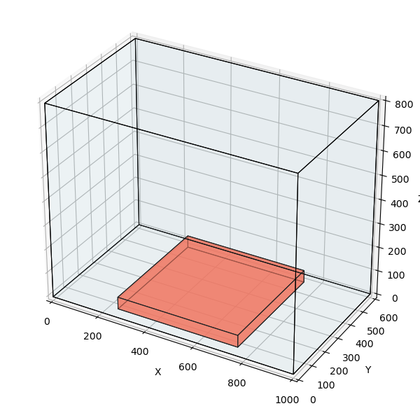
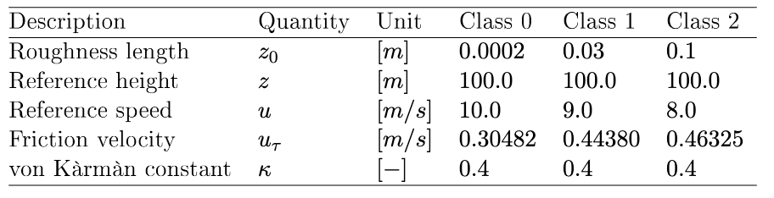
Status update: Bonus 3/5
Bachelor project:
CFD and ROM of Flow over a Golf Court

Slide 5
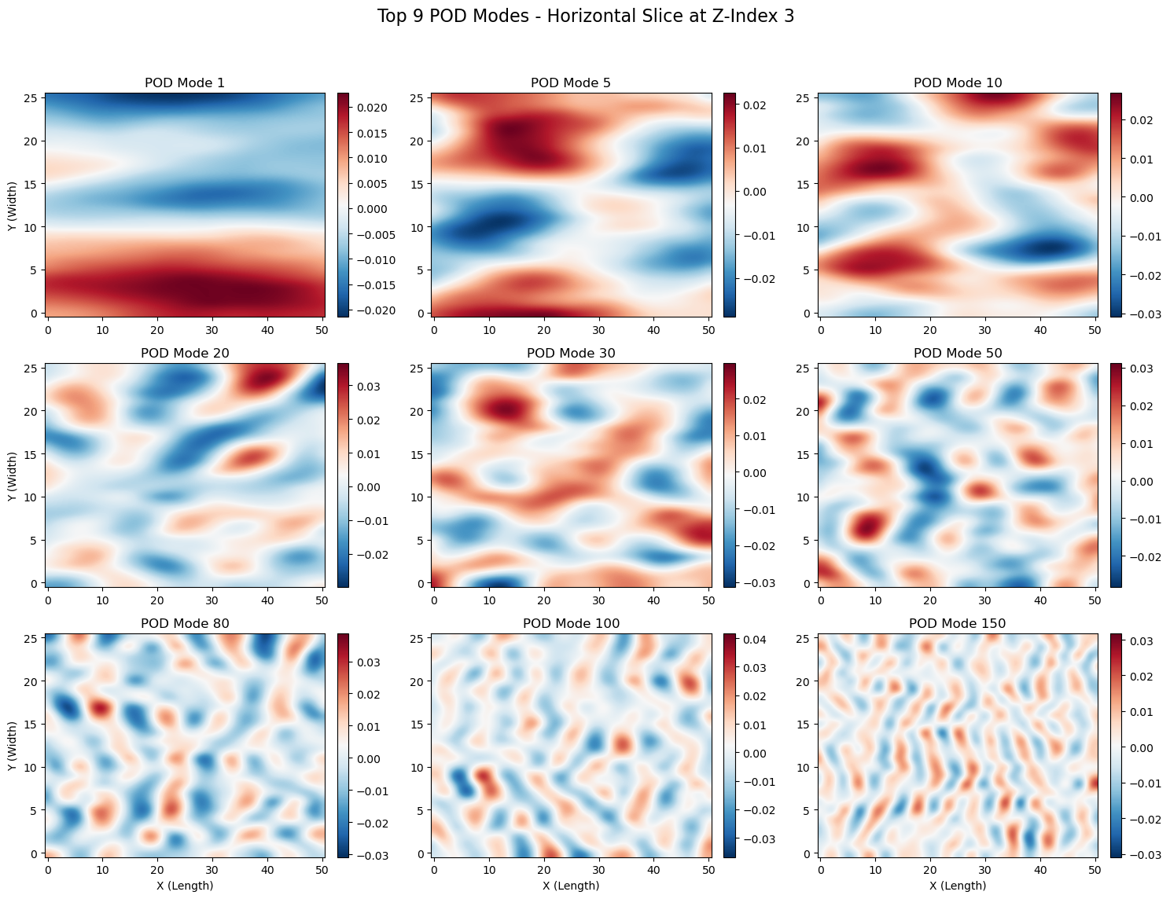
Status update: Bonus 4/5
Bachelor project:
CFD and ROM of Flow over a Golf Court

Slide 6
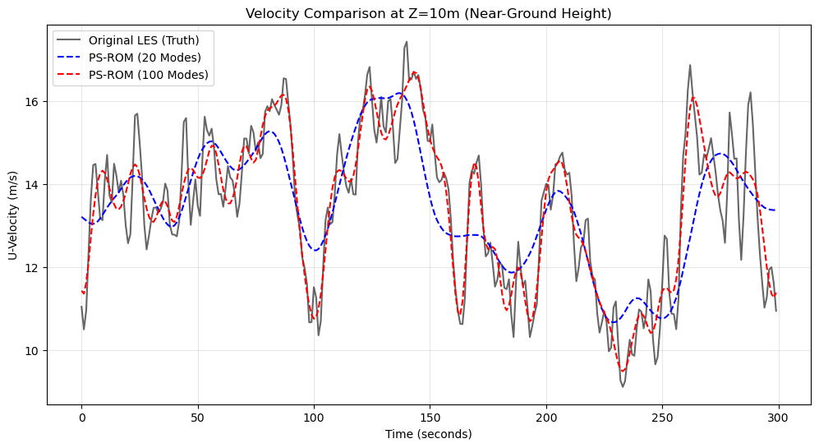
Status update: Bonus 5/5
Bachelor project:
CFD and ROM of Flow over a Golf Court

